Slide 1
INN Hotels Project
By Enoch Adogla
11-19-2021

Slide 2
Overview
This data is from a chain of hotels for INN hotel group in Portugal
Increasing number of booking cancelations are taking a toll on their business
The option to make reservation online and free of charge or at a low cost has made cancelation of reservations easier for customers
Typical reasons for cancellations include change of plans, scheduling conflicts
This data analysis from hotels reservations will :
1. find which factors influence booking cancelations
2. build a predictive model to predict which bookings will be canceled
3. formulat profitable policies for cancelation and refunds

Slide 3
Data-dictionary
Booking_ID: unique identifier of each booking
no_of_adults: Number of adults
no_of_children: Number of Children
no_of_weekend_nights: Number of weekend nights (Saturday or Sunday) the guest stayed or booked to stay at the hotel
no_of_week_nights: Number of week nights (Monday to Friday) the guest stayed or booked to stay at the hotel
type_of_meal_plan: Type of meal plan booked by the customer:
Not Selected – No meal plan selected
Meal Plan 1 – Breakfast
Meal Plan 2 – Half board (breakfast and one other meal)
Meal Plan 3 – Full board (breakfast, lunch, and dinner)
required_car_parking_space: Does the customer require a car parking space? (0 - No, 1- Yes)
room_type_reserved: Type of room reserved by the customer. The values are ciphered (encoded) by INN Hotels.
lead_time: Number of days between the date of booking and the arrival date
arrival_year: Year of arrival date
arrival_month: Month of arrival date
arrival_date: Date of the month
market_segment_type: Market segment designation.
repeated_guest: Is the customer a repeated guest? (0 - No, 1- Yes)
no_of_previous_cancellations: Number of previous bookings that were canceled by the customer prior to the current booking
no_of_previous_bookings_not_canceled: Number of previous bookings not canceled by the customer prior to the current booking
avg_price_per_room: Average price per day of the reservation; prices of the rooms are dynamic. (in euros)
no_of_special_requests: Total number of special requests made by the customer (e.g. high floor, view from the room, etc)
booking_status: Flag indicating if the booking was canceled or not.

Slide 4
Overview of data
Data involves 36275 reservations
12 variables including booking ID were recorded.
15 attributes of the phone sales were covered, including the price of the phone
No missing data or duplicates were observed
About 32.8 percent of all bookings were canceled
The average number of guests per booking is 2
The average number of week nights spent by guests is 2 days.
Majority of the reservations were made online

Slide 5
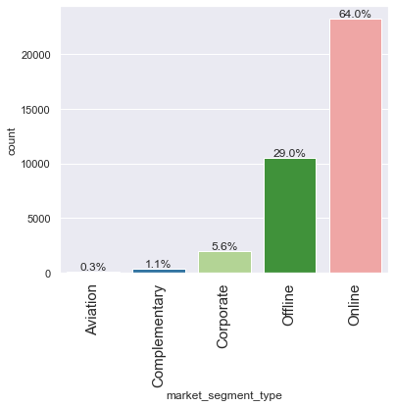
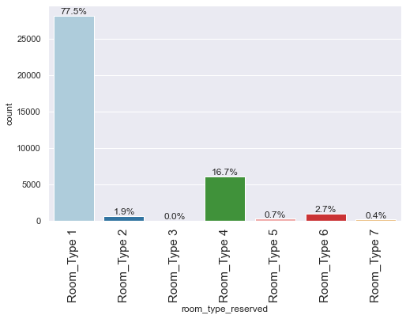
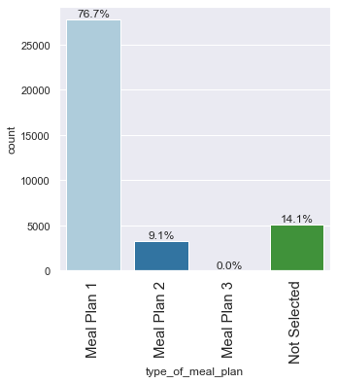
Market segment type and preferences
64% of reservation were made online
29% offline
Meal plan 1 and Room type 1 are the most popular
Preferences for gues

Slide 6
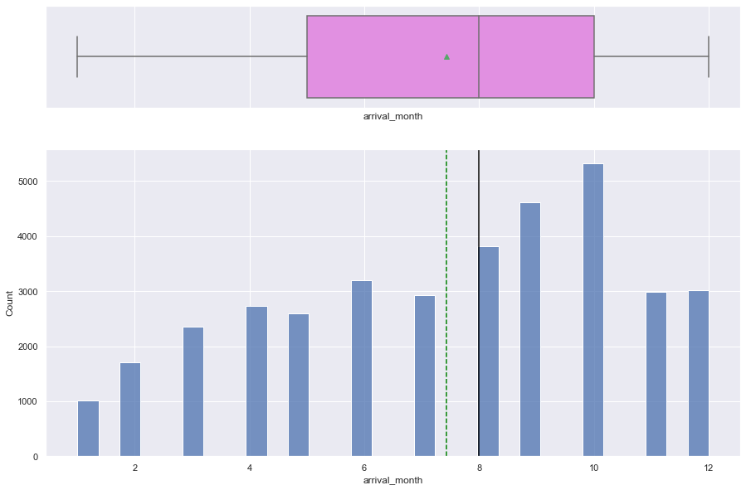
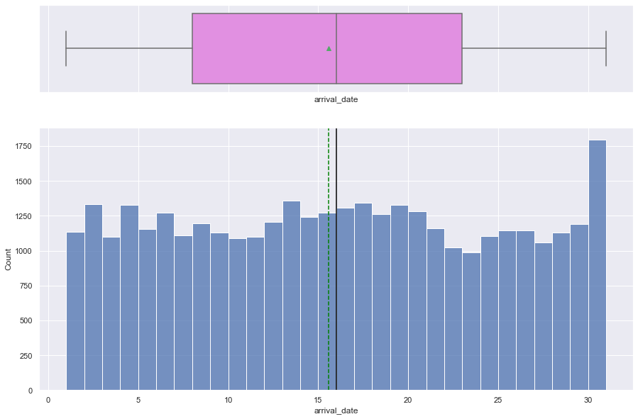
Arrival months
October has the highest number of guest arrivals to the hotels
November is the second highest arrival month
January is the month with the least number of Arrivals
The average number of arrivals per months is 3022
The number of arrivals for the days of the month are fairly uniform

Slide 7
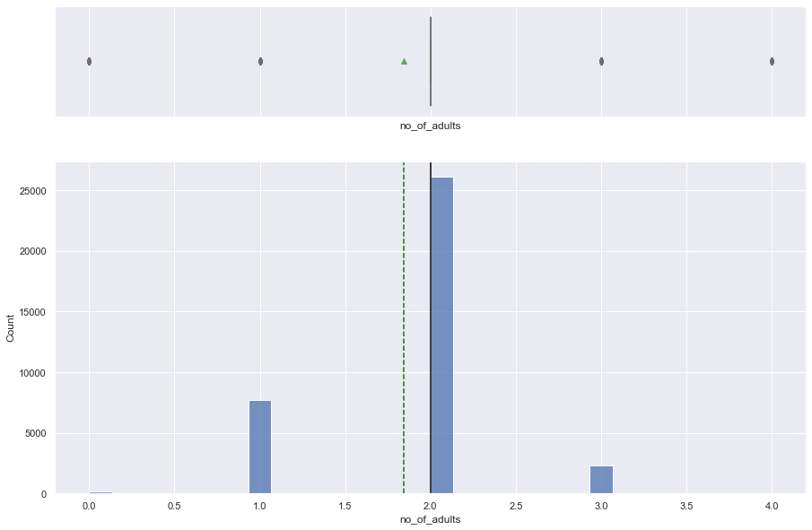
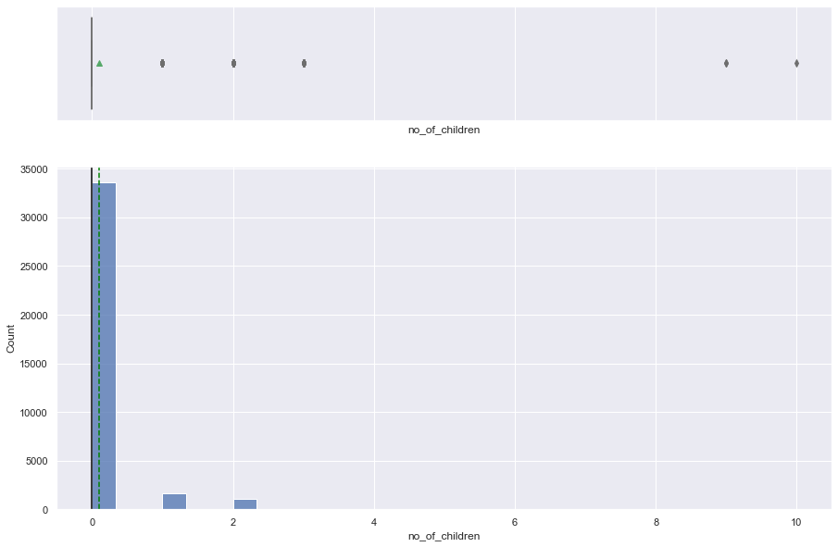
Number of adults or children per booking
The number of adults per booking is from 2-3
The average number of adults per booking is ~2
The number of accompanying children per booking ranges from 0-2

Slide 8
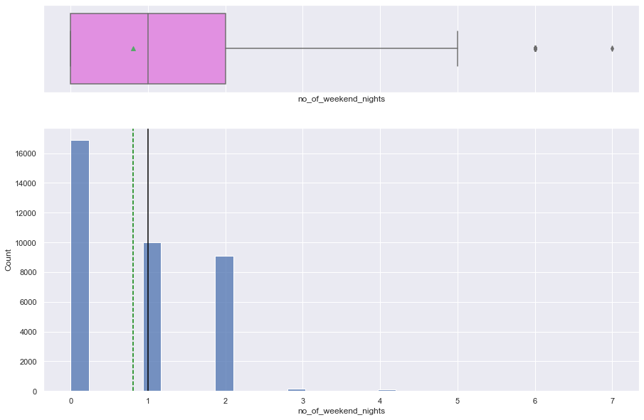
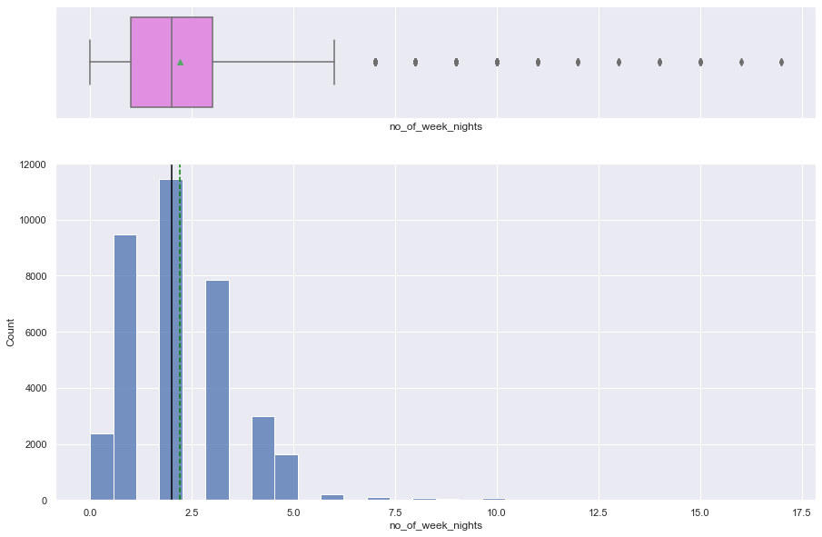
No of weekend nights and weekend nights booked by guests
The number of weekend nights reserved is between 0 and 2
With a mean and median of ~1
The number of week nights reserved is between 0 and 17
with a mean and median of ~2.
The data is rightly skewed

Slide 9
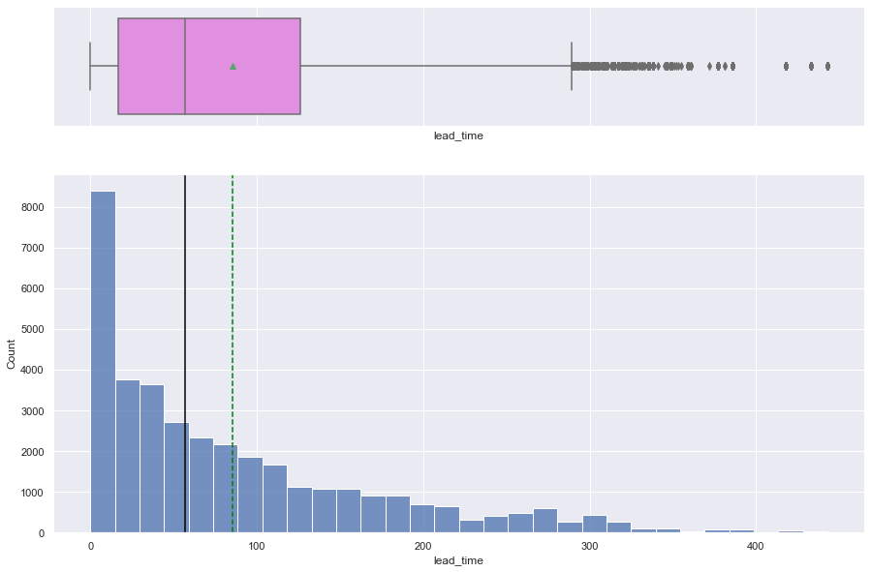
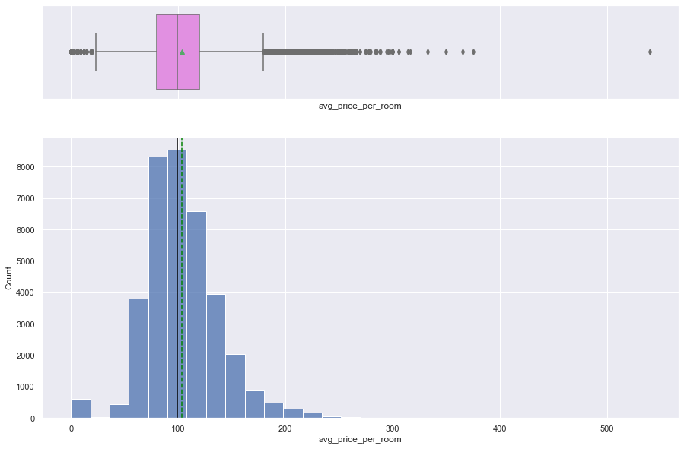
Lead time and room prices
The lead time for the reservations is between 0 to 450 days
The data is rightly skewed
The mean lead time is 83 days
The average and mean price of a room ~ 103.0 euros
The minimum price is 20.7 euros
The maximum price is 179.5 euros

Slide 10
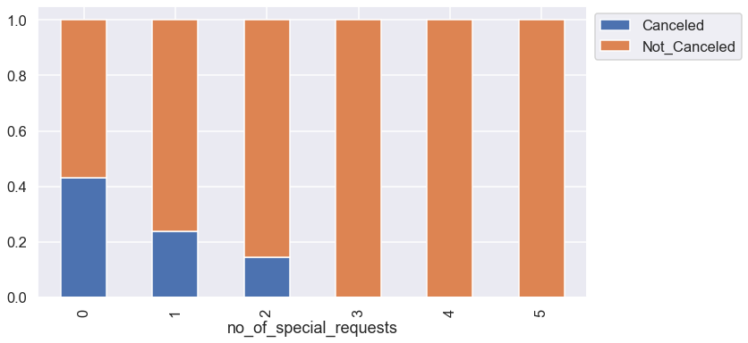
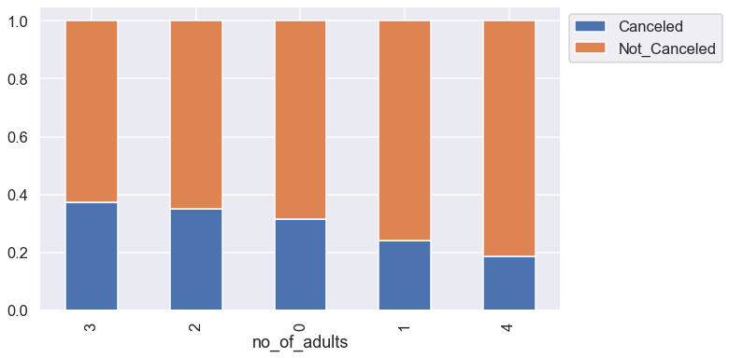
Those who made 3-5 special requests didn’t cancel their
reservation
Over 40% of those who made no special requests cancel
their reservation
Reservations for 1 and 4 adults were canceled more than
reservations for 2 or 3 adults

Slide 11
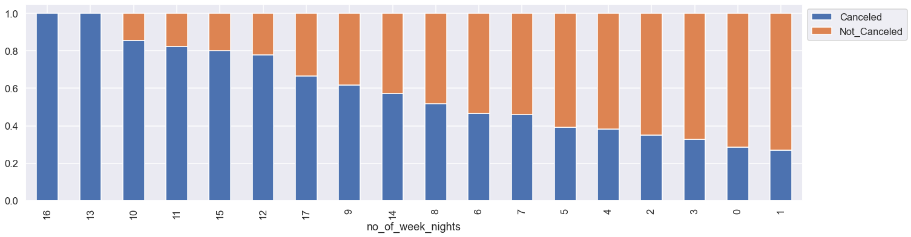
Those who reserved for a higher number of weeknights canceled their reservations more than those who
reserved for a shorter number of week nights

Slide 12
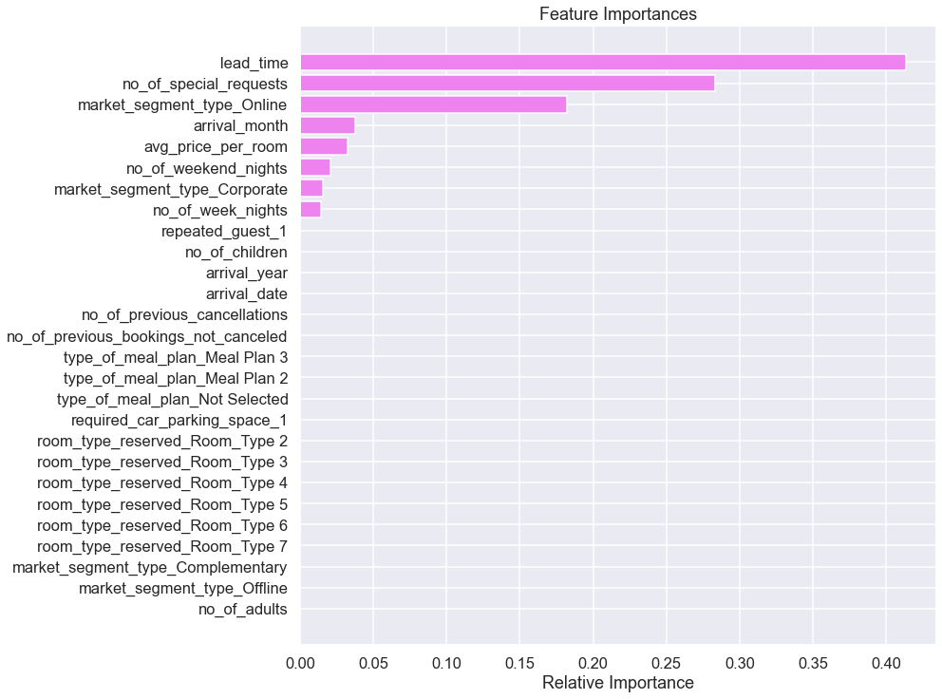
Predictions
Lead time is the most important parameter to consider in determining whether a customer will cancel reservation
No of special guests is the second parameter to consider.

Slide 13
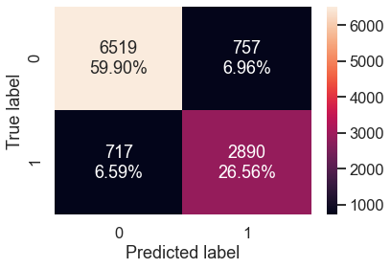
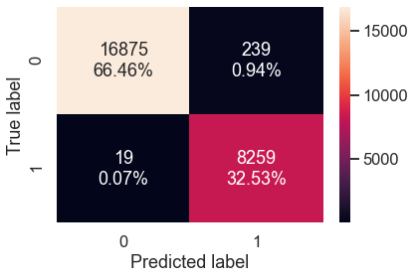
Confusion matrix before pruning
Model is able to classify almost all the data points on the training set.
Less than 1% errors on the training set.
As we know a decision tree will continue to grow and classify each data point correctly if no restrictions are applied as the trees will learn all the patterns in the training set.
This generally leads to overfitting of the model as Decision Tree will perform well on the training set but will fail to replicate the performance on the test set.

Slide 14
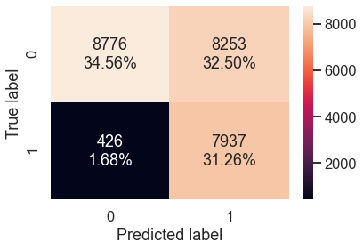
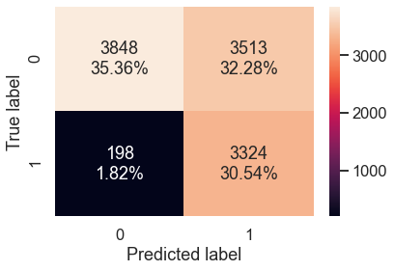
Best model: Confusion matrix after prunning
Train set
Test set
The results have improved from the initial model.
The performance is comparable to the hyperparameter tuned model.
The model is giving a generalized performance on training and test set.

Slide 15
Conclusion
Lead time is the most important factor in determining whether a customer will cancel a reservation
Customers who book with a lead time of 85 or more, have a very high chance of canceling their reservation
The second highest factor is the number of special requests. Customers who make at least three special requests are highly likely to not cancel their reservation
There is more than 40% chance customers who make no special requests will lcancel their reservation
Those who get complimentary bookings are less likely to cancel

Slide 16
Actionable insights
According to our model lead time is the most important factors in wether a custome will cancel his or her reservation
Hotel should send a courtesy reminder to those who book many days ahead, a few days or weeks before their arrival with a note to cancel if they think they can't make it
Hotel should make available more complimentary bookings for customers.

